Slide 1
Deloitte Analytics Insights and Visualization(D-AiV)
Team Name:TIME2LAUNCH
College: VIT University Vellore
Team Captain: Arunava Kar(arunavakar.cse@gmail.com )
Team Members:
Abhishek Mishra(abhishek.mishra2014@yahoo.com )
Yash Agrawal(agrawalyash012@gmail.com )
Dataset:Airplane Crashes Since 1908
Project Link: https://www.kaggle.com/arunava21/d/saurograndi/airplane-crashes-since-1908/deloitte-e-maverick-analysis-by-time2launch/

Slide 2
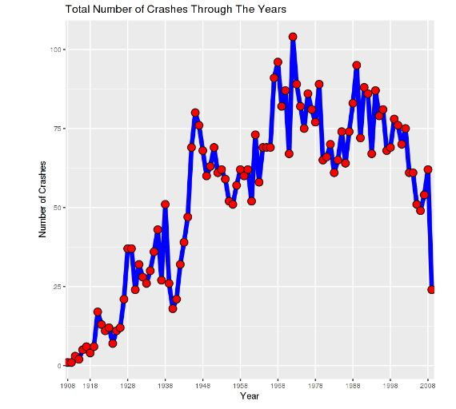
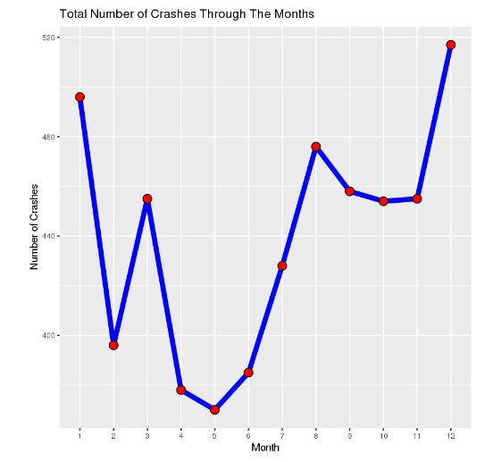
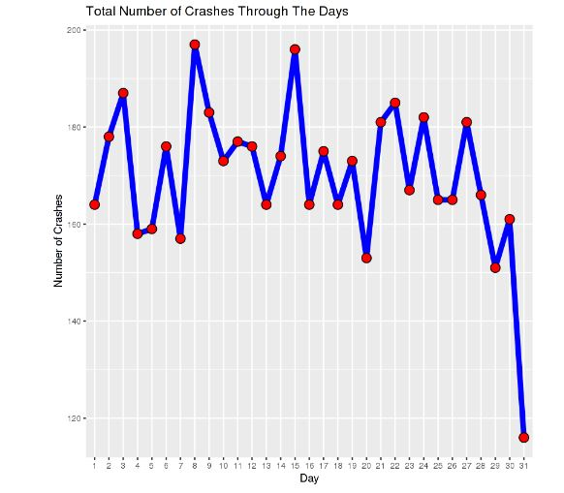
Distribution of Crashes over Years, Months and Days.

Slide 3
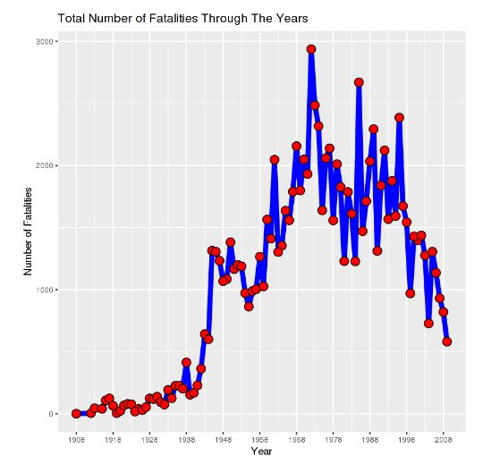
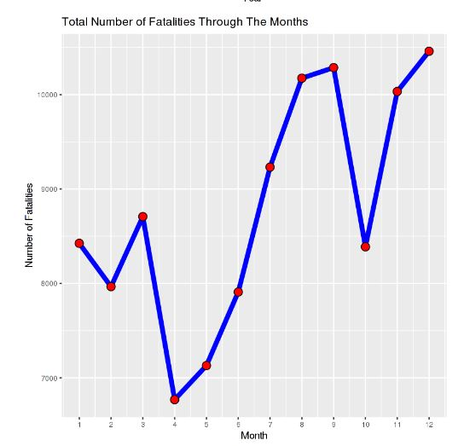
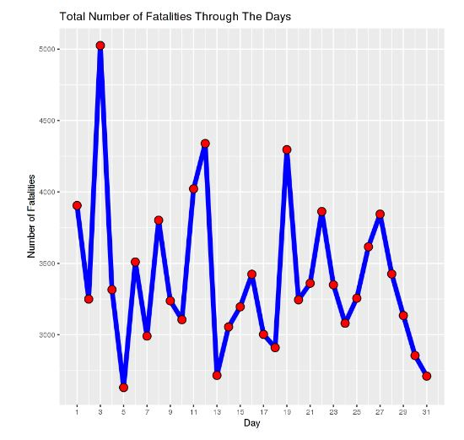
Distribution of Fatalities over Years, Months and Days.

Slide 4
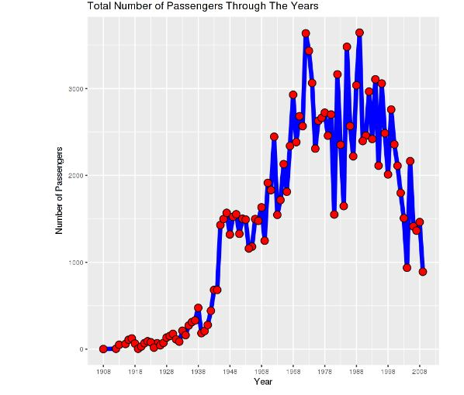
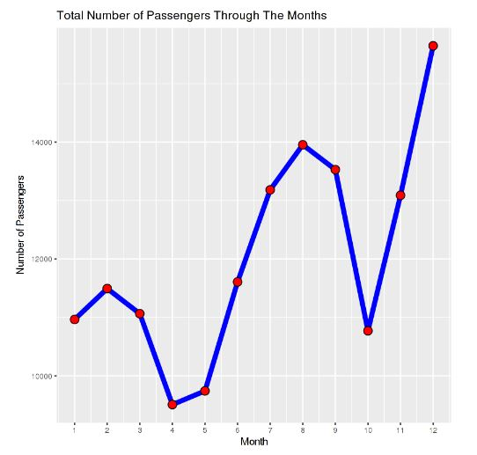
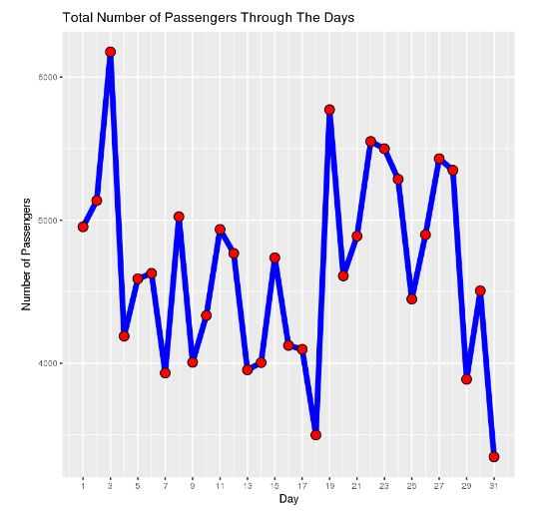
Distribution of Passengers over Years, Months and Days.

Slide 5
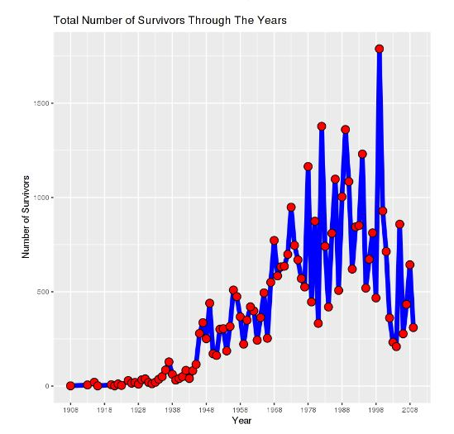
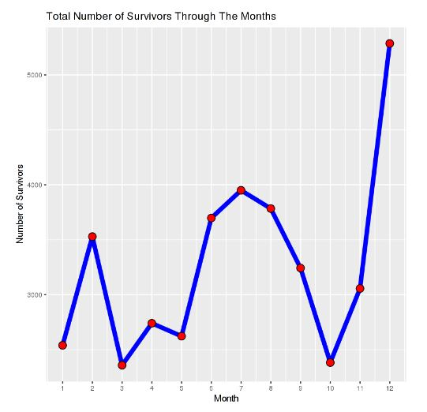
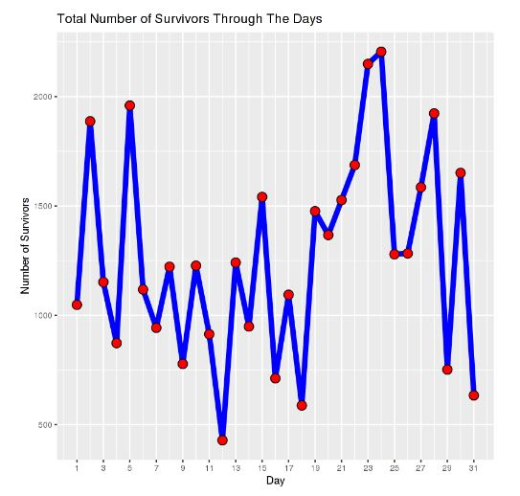
Distribution of Survivors over Years, Months and Days.

Slide 6
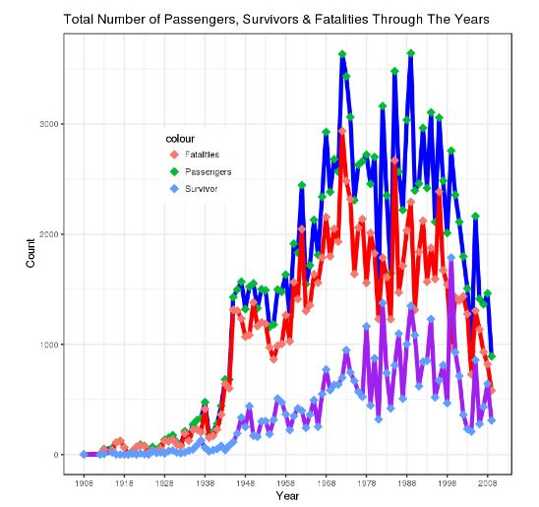
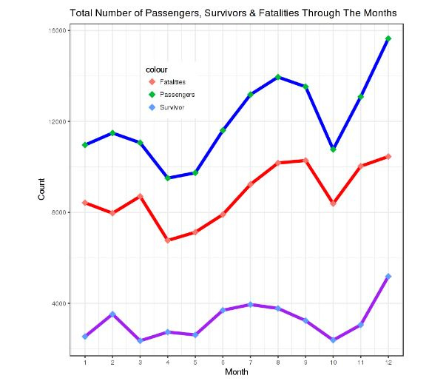
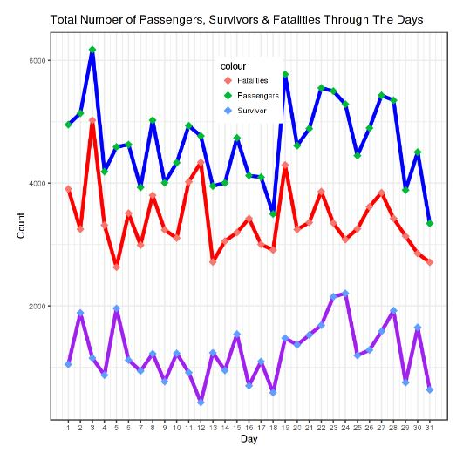
Distribution of Passengers, Survivors and Fatalities over Years, Months and Days.

Slide 7
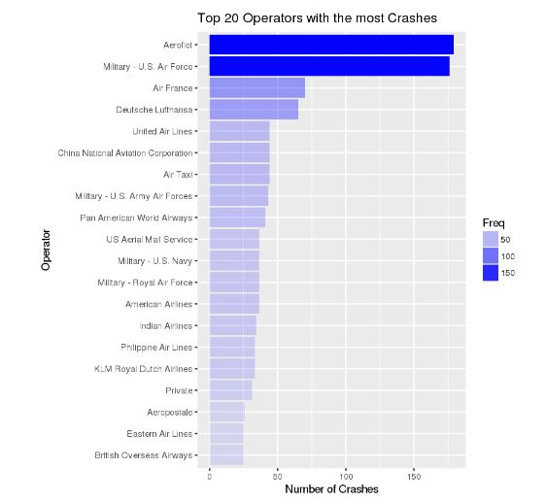
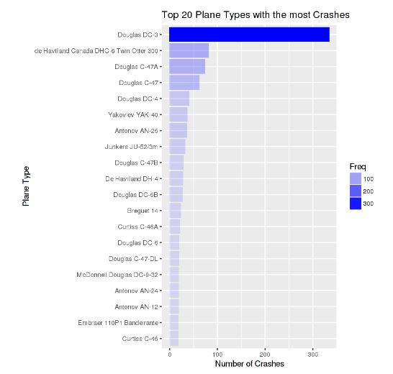
Distribution of Plane Types and Operators with most Crashes.

Slide 8
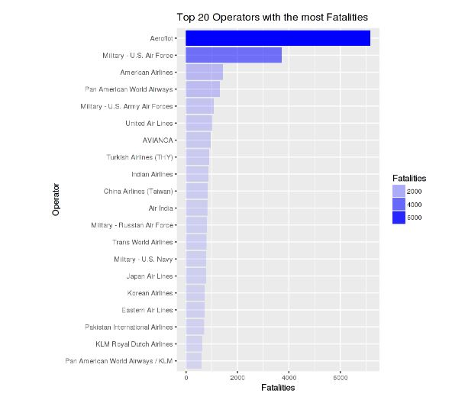
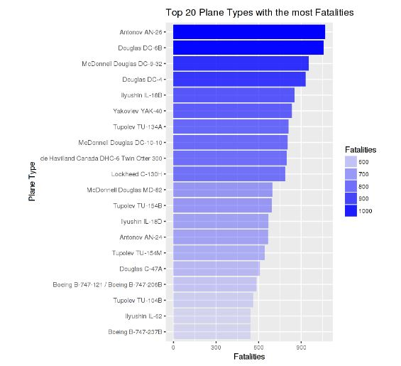
Distribution of Plane Types and Operators with most Fatalities.

